Slide 1

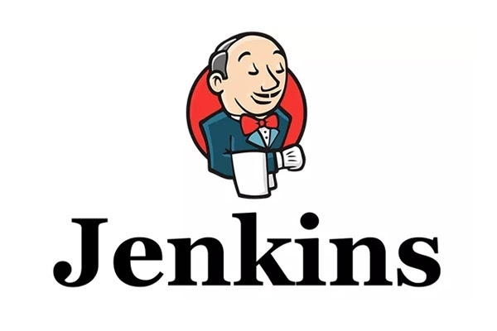
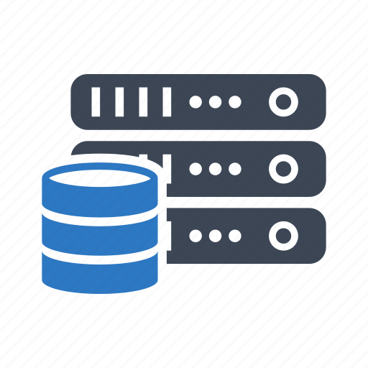
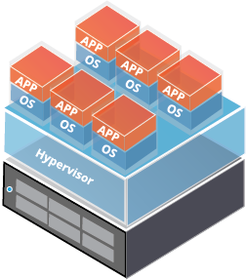
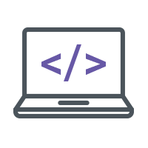
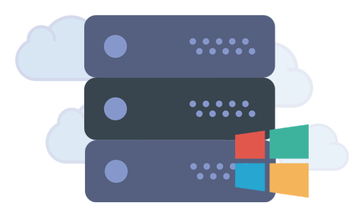
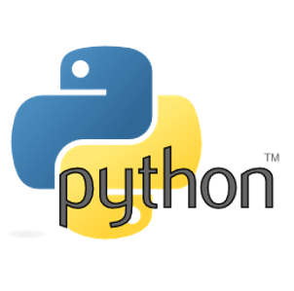






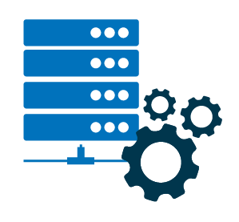
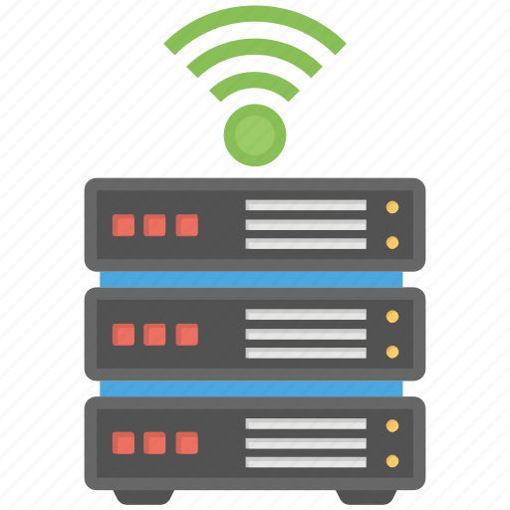
Automation Framework
Continuous Build / Git Pull
Storage Clients
Virtualization Clients
Check In / Git Push
Continuous Delivery
Windows Clients
Deployment
Deployment
Deployment
Deployment
Source Code
Deployment
Linux Clients
Deployment
Physical hardware Clients
Network Clients

